Slide 1
Classification

Slide 2
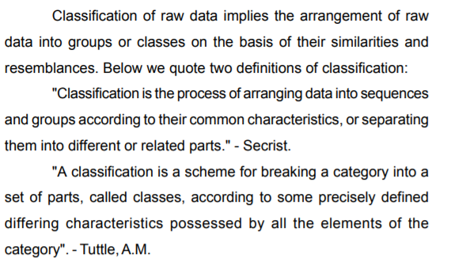
Classification of data

Slide 3
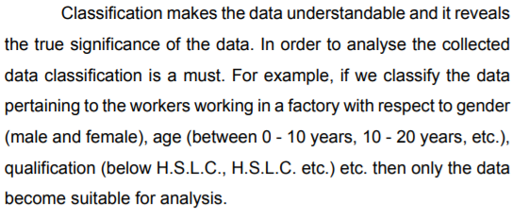
Classification of data

Slide 4
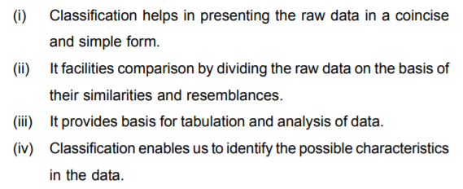
Advantages & Importance of Classification

Slide 5
Types of Classification
Geographical Classification
Chronological Classification
Qualitative Classification
Quantitative Classification

Slide 6
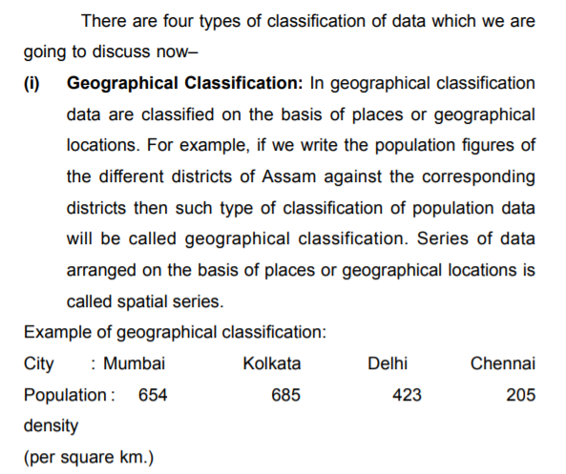
Types of Classification

Slide 7
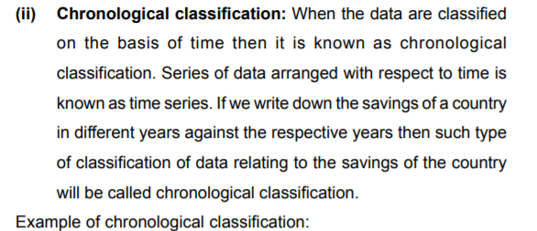
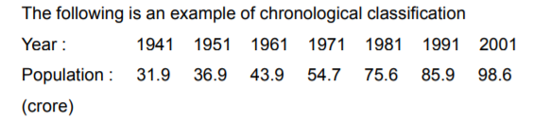
Types of Classification

Slide 8
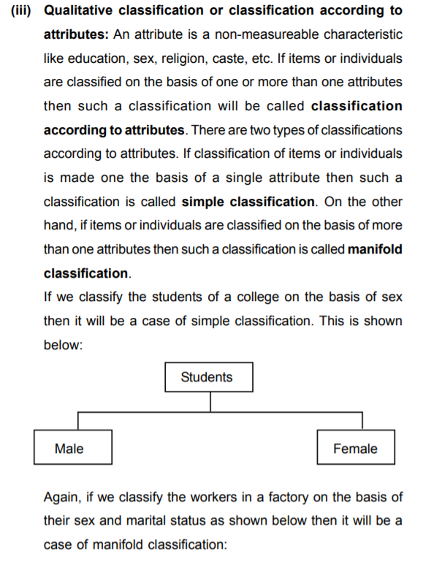

Slide 9
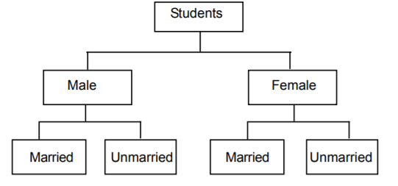

Slide 10
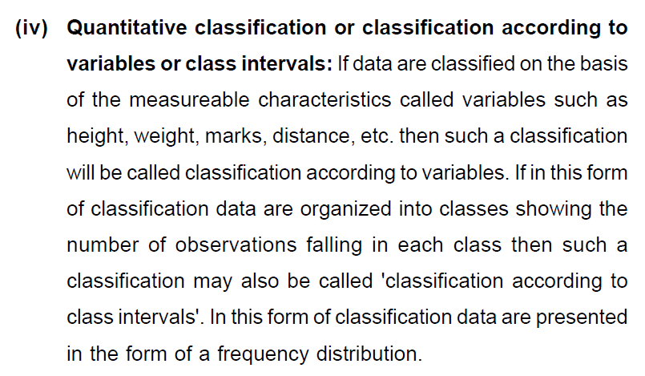

Slide 11
Frequency Distribution

Slide 12
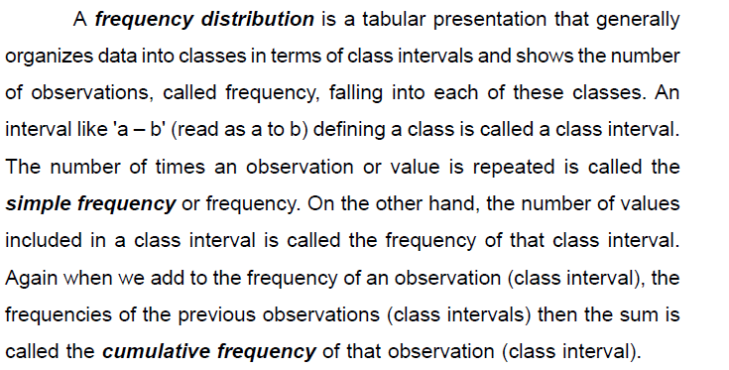
Frequency Distribution

Slide 13
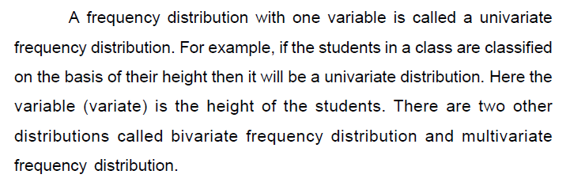
Frequency Distribution…

Slide 14
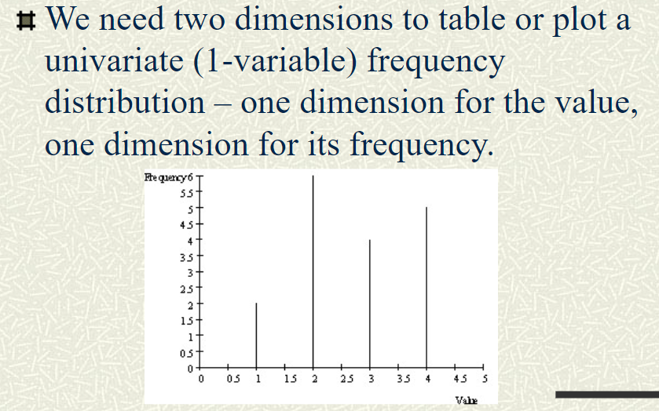
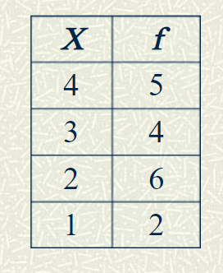
1. Univariate Frequency Distribution

Slide 15
1. Univariate Frequency Distribution

Slide 16
Types of Univariate Frequency Distribution
Individual Observation
Discrete Frequency Distribution
Continuous Frequency distribution

Slide 17
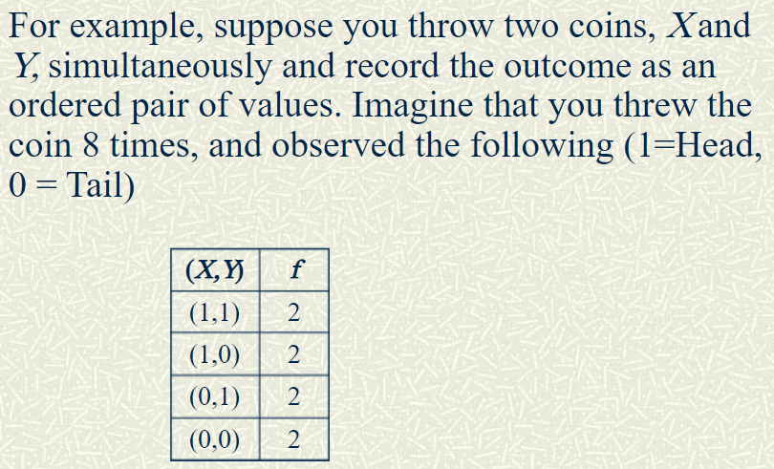
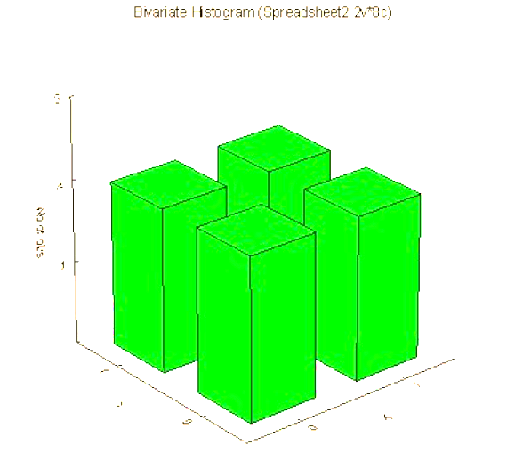
2. Bivariate/Two-way Frequency Distribution

Slide 18
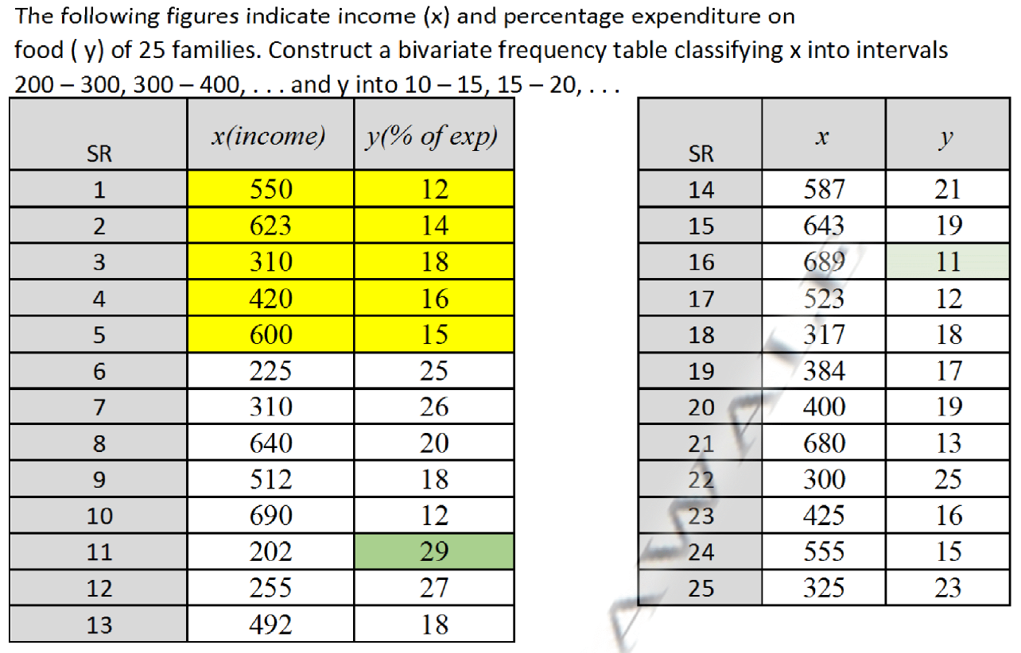
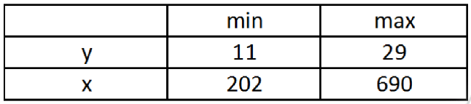
Bivariate/Two-way Classification of Data

Slide 19
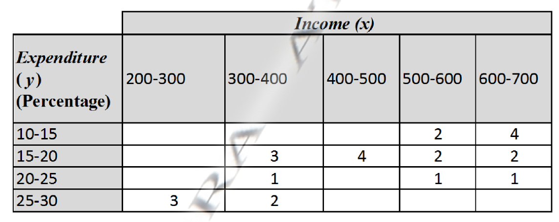

Bivariate/Two-way Classification of Data

Slide 20
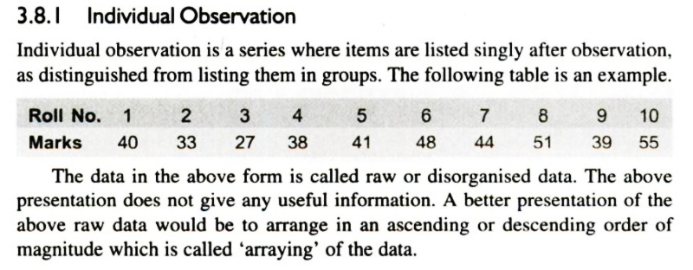
Types of Univariate Frequency Distribution

Slide 21
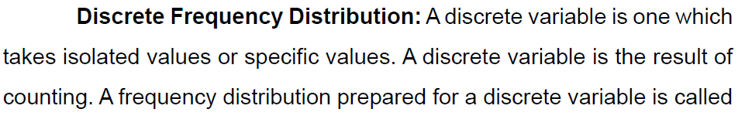
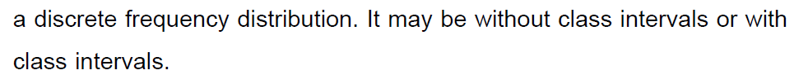
Frequency Distribution…

Slide 22
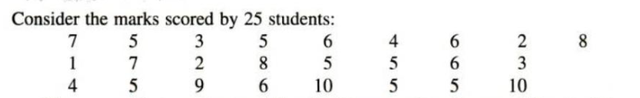
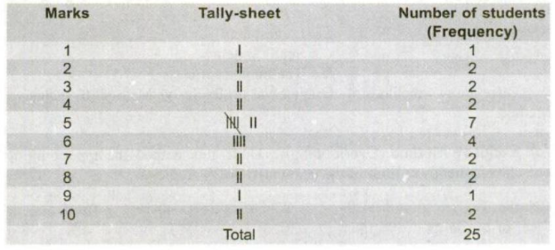
Frequency Distribution…
Ungrouped Frequency Distribution

Slide 23
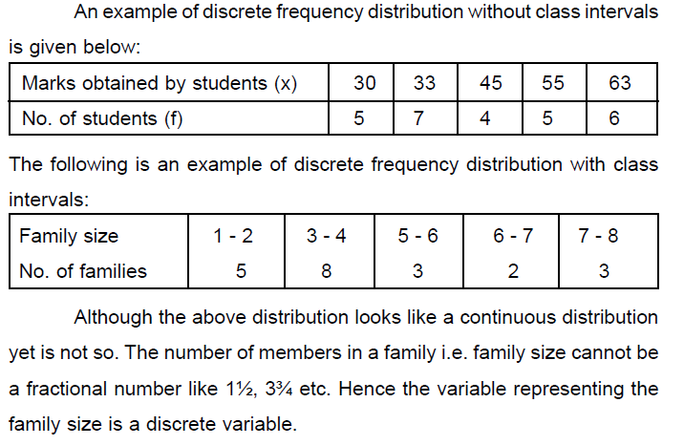
Frequency Distribution…
Ungrouped Frequency Distribution

Slide 24
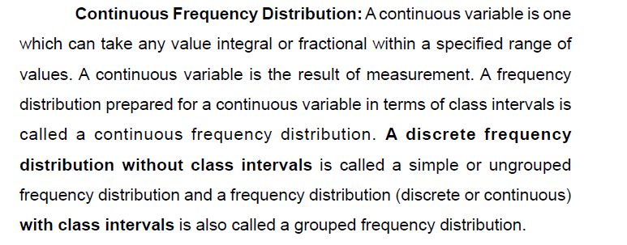
Frequency Distribution…

Slide 25
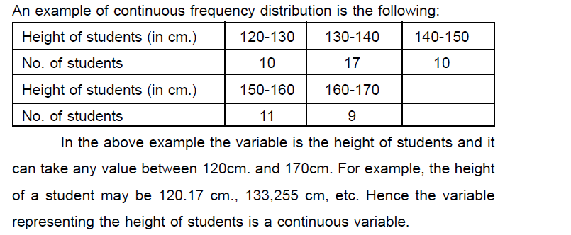
Frequency Distribution…
Grouped Frequency Distribution

Slide 26
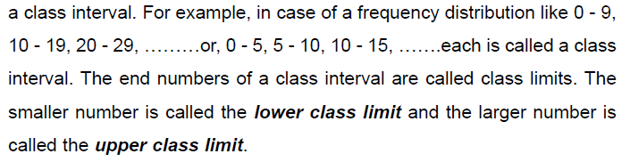
Frequency Distribution…

Slide 27
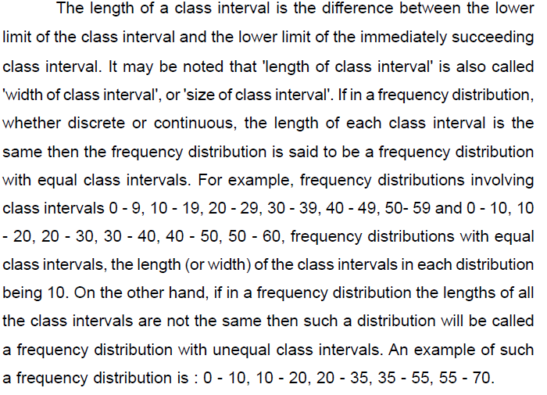

Slide 28
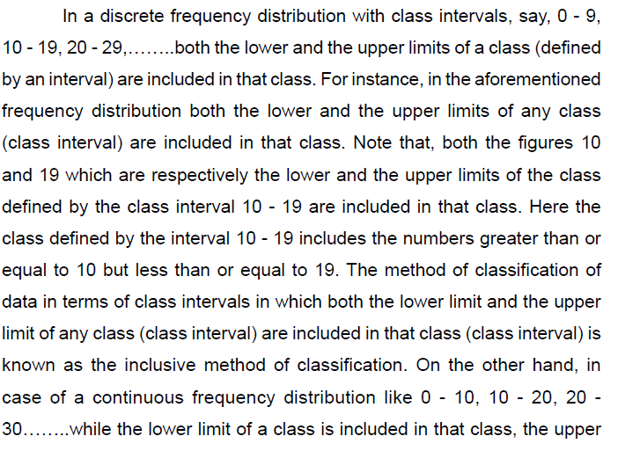
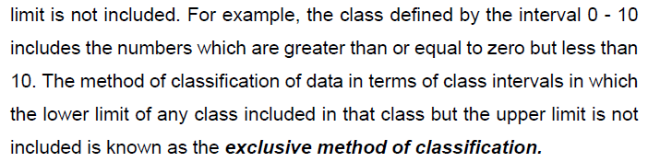

Slide 29
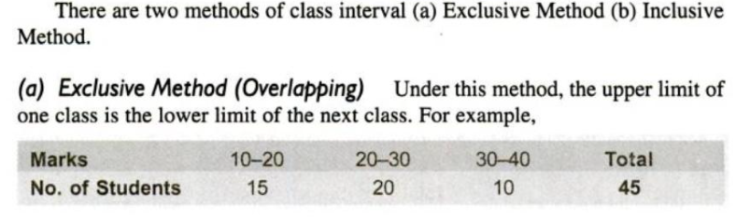
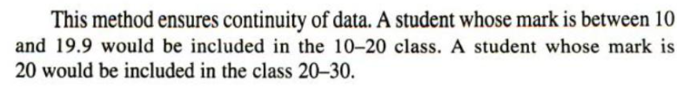
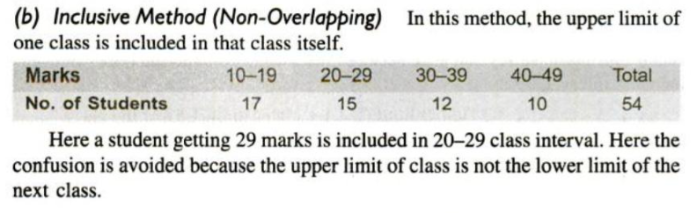

Slide 30
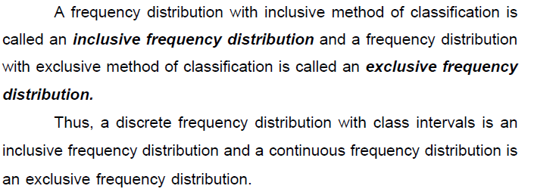

Slide 31
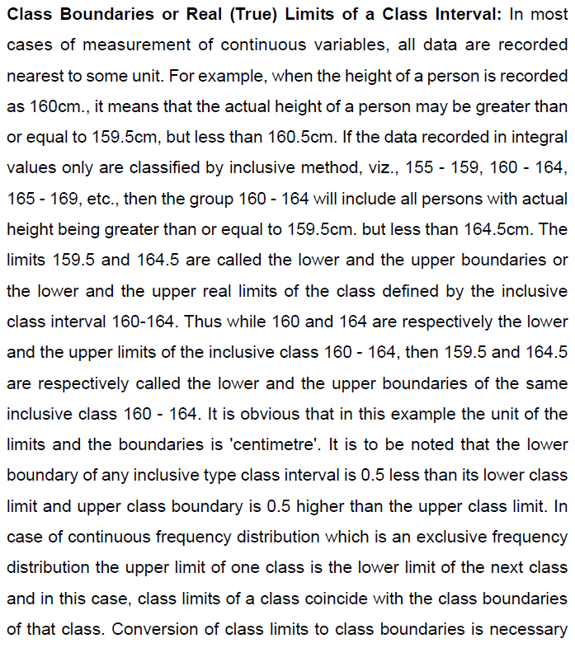

Slide 32
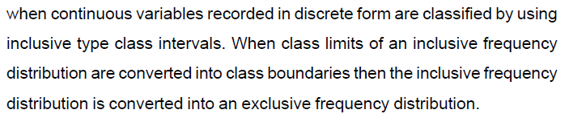

Slide 33
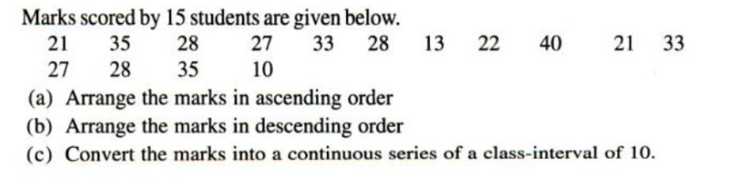

Slide 34
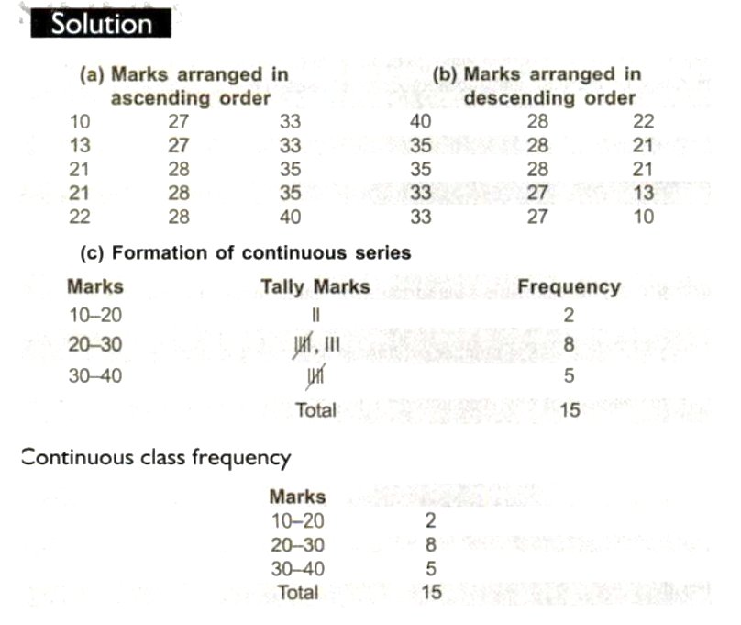

Slide 35
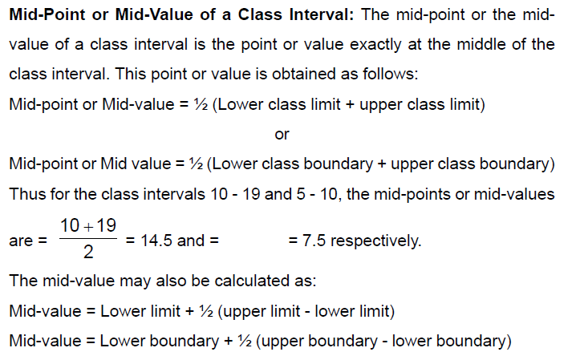

Slide 36
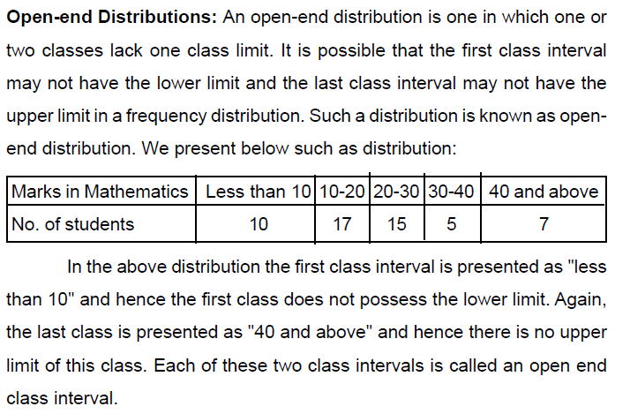

Slide 37
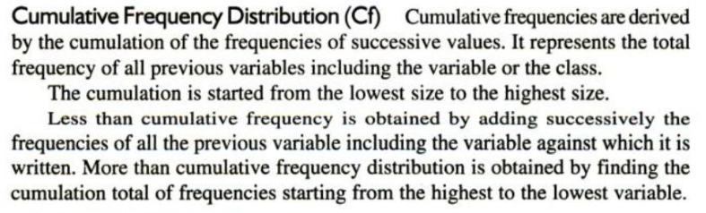
Cumulative Frequency (Cf) Distribution

Slide 38
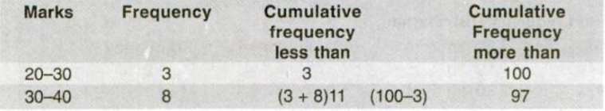
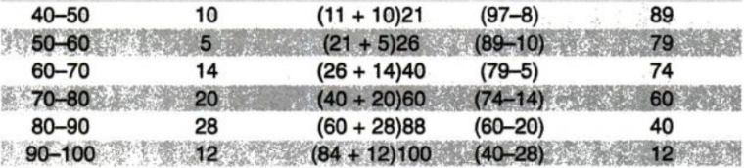
Cumulative Frequency (Cf) Distribution

Slide 39
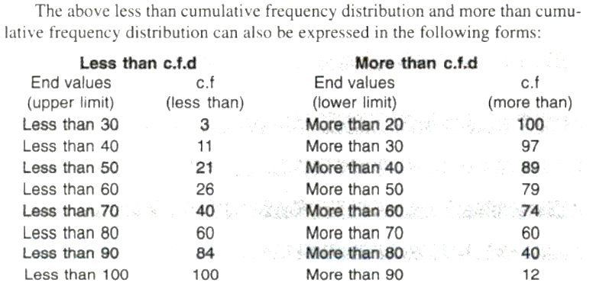
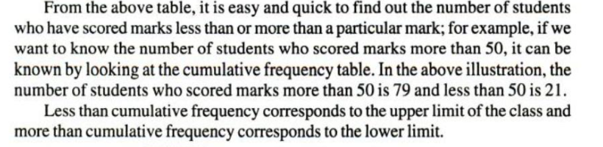
Cumulative Frequency (Cf) Distribution

Slide 40
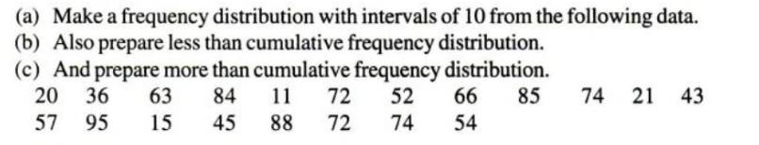

Slide 41
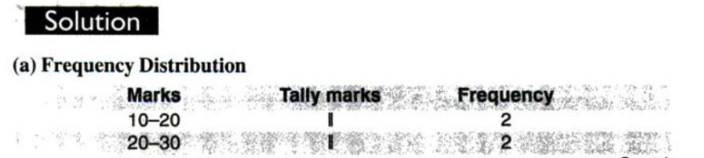
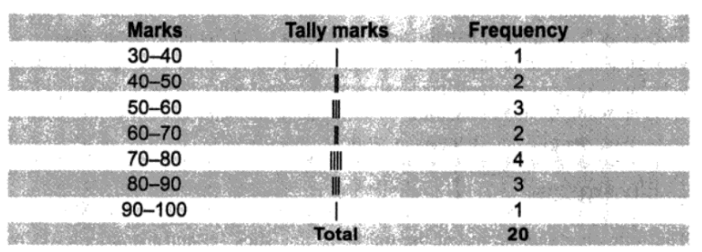

Slide 42
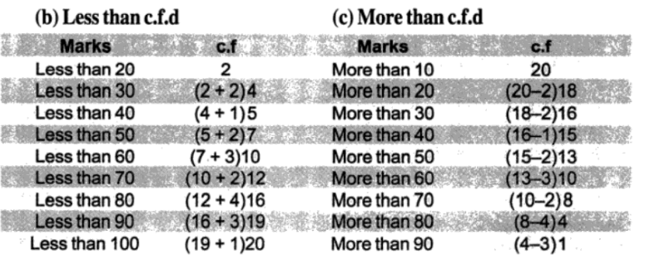

Slide 43
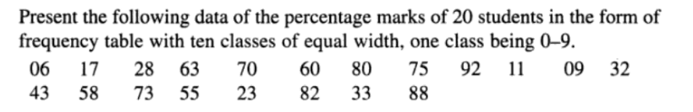

Slide 44


Slide 45


Slide 46


Slide 47


Slide 48


Slide 49


Slide 50


Slide 51
Bivariate/Two-way Classification of Data

Slide 52
Bivariate/Two-way Classification of Data

Slide 53

Measures of Central Tendency OR

Slide 54


Slide 55

Arithmetic Mean

Slide 56

Arithmetic Mean

Slide 57


Slide 58


Slide 59



Slide 60

Find Median of the given data

Slide 61


Slide 62


Slide 63


Slide 64


Slide 65


Slide 66


Slide 67
Classification of data

Slide 68
Classification of data

Slide 69
Advantages & Importance of Classification

Slide 70
Types of Classification

Slide 71
Types of Classification

